Slide 1


Automatic Speech Recognition for Badaga Language
GROUP- 08

Slide 2

Introduction
• Automatic Speech Recognition (ASR) enables machines to understand human speech.
Badaga, spoken by a small community in India, has limited digital linguistic resources
• Research on low-resource languages like Badaga is limited.
• This study focuses on developing an efficient ASR model for the Badaga language using deep learning techniques.

Slide 3

Problem Definition
Low-resource languages like Badaga lack sufficient transcribed speech data, making it challenging to develop accurate ASR systems. Traditional HMM-based models require handcrafted features, which are impractical for such languages.
This research proposes an end-to-end ASR model using a CTC-based RNN to directly map speech signals to text, improving accuracy and scalability for Badaga..

Slide 4

OBJECTIVE
Develop an End-to-End ASR Model – Implement a CTC-RNN-based model for recognizing and transcribing spoken Badaga language.
Improved ASR Performance for Badaga – Achieving lower Word Error Rate (WER) using the CTC-RNN model.
First End-to-End ASR for Badaga – Developing a deep learning-based ASR system specifically for the Badaga language.

Slide 5

Literature Review
Model Description | Dataset | WER (%) | Source
RNN combined with Connectionist Temporal Classification (CTC) | Wall Street Journal (WSJ) | 30.1 | https://www.mdpi.com/2073-8994/11/8/1018#B27-symmetry-11-01018 -An Overview of End-to-End Automatic Speech Recognition
CNNs and Transformer-based self-attention | Not specified | 2.1/4.3 | https://arxiv.org/abs/2005.08100 Convolution-augmented Transformer for Speech Recognition
Tamil ASR model based on Mozilla DeepSpeech architecture | Not specified | 55 | .https://cdn.techscience.cn/ueditor/files/iasc/TSP_IASC-32-2/TSP_IASC_22021/TSP_IASC_22021.pdf.
Direct Speech-to-Text Translation | Not specified | N/A | https://arxiv.org/pdf/2306.11646 - "Recent Advances in Direct Speech-to-Text Translation“
CNN model | Low-resource Turkic languages with common alphabets | 17.4 | https://www.nature.com/articles/s41598-024-64848-1- Multilingual end-to-end ASR for low-resource Turkic languages with common alphabets.

Slide 6
Model Description | Dataset | WER (%) | Source
ASR for Low-Resource Phonetic Languages Output Alphabet Reduction and Reconstruction Module; | Mvskoke | 7 | ttps://aclanthology.org/2024.acl-srw.16.pdf-ASR for Low-Resource Phonetic Languages Output Alphabet Reduction and Reconstruction Module Mvskoke language
Fine-Tuning ASR Models for Very Low-Resource Languages; HMM and E2E | Not specified | 24.7 | https://aclanthology.org/2024.acl-srw.16.pdf-Fine-Tuning ASR Models for Very Low-Resource Languages HMM and E2E
Whisper multilingual ASR model Cross-entropy for Low-Resource Languages in ASR | Low-Resource Languages | 3.29 | . https://www.arxiv.org/abs/2409.16954 - Whisper multilingual ASR model Cross-entropy for Low-Resource Languages in ASR.
Direct Speech-to-Text Translation | Not specified | N/A | https://arxiv.org/pdf/2306.11646 - "Recent Advances in Direct Speech-to-Text Translation“

Slide 7

Research Gaps
• Identified Gaps:
Previous methods relied on HMM-GMM models, which require extensive feature engineering this is a traditional method.
• How this research addresses the gaps:
we are using end-to-end models like CTC and RNN can directly learn from raw speech but remain unexplored for Badaga.

Slide 8

methodology
Data Collection: Gather and preprocess speech recordings of the Badaga language, ensuring quality and consistency.
Feature Extraction: Extract relevant acoustic features from the audio signals, such as Mel-frequency cepstral coefficients (MFCCs) or Mel-spectrograms. These features will serve as input to the model.
Model Selection: Use an End-to-End ASR model .
CTC-based Wav2Vec2: A speech recognition model where the Wav2Vec architecture is fine-tuned using a loss function called "Connectionist Temporal Classification (CTC)" which allows the model to learn from unaligned audio and text data
Training & Optimization: Implement the model using TensorFlow/PyTorch, optimizing it with suitable loss functions and hyperparameters.
Evaluation: Assess model performance using metrics like WER (Word Error Rate) and CER (Character Error Rate).

Slide 9
Wav2vec2
• Wav2Vec2 is a pretrained model for Automatic Speech Recognition (ASR)
Facebook AI presented a multi-lingual version of Wav2Vec2, called XLSR. XLSR stands for cross-lingual speech representations and refers to model's ability to learn speech representations that are useful across multiple languages.
They are firstly trained with audio only for representation learning, then fine-tuned for a specific task with additional labels.

Slide 10
CTC in wav2vec2
Feature extraction:
The Wav2Vec2 model first extracts features from the audio input, creating a sequence of feature vectors representing the speech.
CTC output layer:
The model's final layer outputs a probability distribution over the vocabulary (including the blank token) for each time step in the feature sequence.
Loss calculation: wer(word error rate)
The CTC loss function compares the model's output probabilities to the ground truth text, taking into account all possible alignments between the predicted characters and the target text
The model updates its parameters based on the calculated CTC loss to improve its ability to predict the correct character sequence for a given audio input

Slide 11
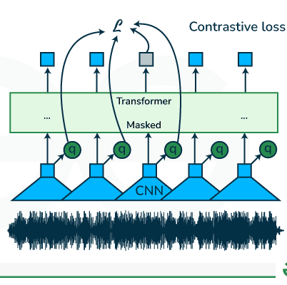
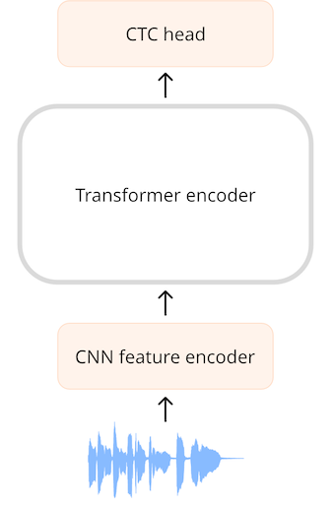
Block Diagram
Figure 1: Wav2Vec 2.0 model architecture
Figure 2: ctc model architecture

Slide 12

DESCRIPTION OF DATASET
It contains Badaga audio and Badaga xlsx
Total dataset duration is 6.48 hr
In Badaga xlsx total data 9838 and 9 columns
Items, translated_transcript, audio_file_name, translterated_script, user_id, gender, locale, split_label, duration.
Dataset Split count
Train : 6897
Test : 1470
Validation : 1470

Slide 13
IMPLEMENTATION
Loading Dataset
Keeping wanted columns (audio_file_name, Translterated_script, split_label) and Removing unwanted columns
Removing unwanted symbols form Translterated_script using regex
Creating Vocabulary
Classify speech chunks into letters.
Extracts unique characters from the combined text to build a vocabulary.
Use mapping function to apply the function to all transcriptions at once
Save the vocabulary to .json file for tokenization and training
Adding Padding Tokens
Unk (unknown token): handles out of vocabulary character.
Pad (padding token): used for padding sequences.
| : Represents space b/w words
We use the json file to load the vocabulary into Wav2Vec2CTCTokenizer class.

Slide 14
Creating a wav2vec2FeatureExtractor
Feature size =1
Sampling rate=16000
Padding value=0.0
Normalize = true (normalizes the waveform to zero-mean)
Attention mask to ignore padded values
Data Preparation
Load the dataset.
Extract the audio path.
Read the audio and check its sample rate.
Resample it to 16 kHz (using ‘audio’ function )
Training Setup
The model gets batches prepared by DataCollatorCTCwithPadding.
The training script loads a batch and model receives the padded batch.
CTC loss function ignores padded labels (-100).

Slide 15

Defining
Defining the evaluation metrics.
Word error rate (wer)
S = no.of wrong words
D = no.of missing words
I = no.of extra words
N = Total no of words in the actual transcription
Loading
Loading the pre trained model
We use ‘xls-r-300m’ variant
Training
Training Parameters
Batch size=16
Steps before backpropagation=2
Train epochs=2
Save steps=50
Log metrics= 20

Slide 16
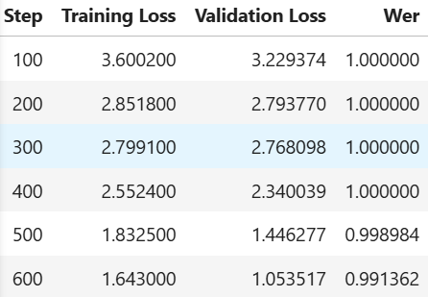
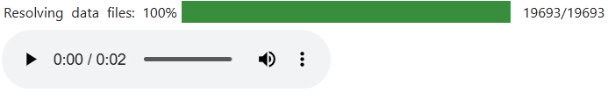
RESULT
Figure 5: Training output
Figure 4: resampled audio (16000)

Slide 17
REFERENCES
1.Tamil ASR (DeepSpeech-based) "Tamil ASR model based on Mozilla DeepSpeech architecture," IASC Proceedings, 2021. Available: https://cdn.techscience.cn/ueditor/files/iasc/TSP_IASC_32-2/TSP_IASC_202021.pdf.
2.Direct Speech-to-Text Translation A. Gulati et al., "Recent Advances in Direct Speech-to-Text Translation," arXiv preprint, 2023. Available: https://arxiv.org/pdf/2306.11646.
3.ASR for Low-Resource Phonetic Languages (Mvskoke) J. White et al., "ASR for Low-Resource Phonetic Languages: Output Alphabet Reduction and Reconstruction Module," ACL Anthology, 2024. Available: https://aclanthology.org/2024.acl-srw.16.pdf.
4.Fine-Tuning ASR Models for Very Low-Resource Languages H. Rao et al., "Fine-Tuning ASR Models for Very Low-Resource Languages: HMM and E2E," ACL Anthology, 2024. Available: https://aclanthology.org/2024.acl-srw.16.pdf.

Slide 18
THANK YOU
VASISTA –CB.EN.U4AIE22134
NANDANA-CB.EN.U4AIE22138
SNEGA-CB.EN.U4AIE22163
DAKSHINYA-CB.EN.U4AIE22169

